Slide 1
Translation Issues Meeting # 2
September 9, 2019

Slide 2
Objectives
Database structure – dealing with layers and land cover components
Review implementation of PRODUCTIVE_FOR for BC and New Brunswick (maybe Alberta)
Review the definition and general rules for PRODUCTIVE_FOR
Review list of priority issues and attributes to discuss over the next few weeks

Slide 3
Database structure
This issue relates to how the CASFRI database is organized. Here are a few observations and questions:
In BC, non-forest polygons can be entire polygons or components within polygons.
In NB, the source data consists of 4 non-overlapping shapefiles: forest, non-forest, waterbody, and wetlands.
Should LYR tables only include polygons that are considered forested?
Can multiple layers occur in DST and NFL tables?
What criteria should we use for including/excluding polygons in LYR, NFL, and DST tables?

Slide 4
Layers non-forest components: NB and BC
New Brunswick
Inventory includes 4 non-overlapping shapefiles:
Forest
Non-forest
Waterbody
Wetlands
Inventory includes 2 layers
Separate LYR in LYR1 and LYR2
Separate DST in DST1 and DST2
British Columbia
Inventory includes 1 geodatabase
Forest polygons can have non-forest components which means we could have “non-forest” polygons and “forest” polygons with non-forest components
See examples on next slide…

Slide 5
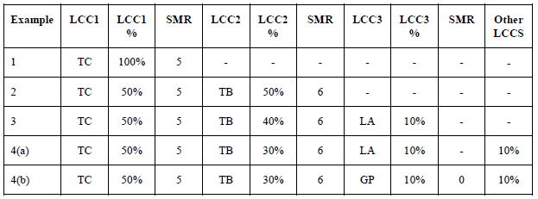
BC Land cover components

Slide 6
PRODUCTIVE_FOR (2019)
Productive forest is forest land capable of producing trees for forest operations. Unproductive forest is forest land not capable of producing trees for forest operations. They are usually wetlands, very dry sites, exposed sites, rocky sites, higher elevation sites, or those sites with shallow or poor soils.
Value | Description | CAS04 | 2011
NP | Non-productive forest - poor forest types on rocky or wet sites | 8,849 | NP
PF | Productive forest - any other forest | 18,551,934 | P
PP | Potentially productive - no species code, no mention of unproductivity, but there is height, crown closure or density | 4,425,539
SC | Scrub Coniferous - scrub coniferous trees on poor sites | 157,818 | SC
SD | Scrub Deciduous - scrub deciduous trees on poor sites | 32,472 | SD
TM | Treed musked - treed wetland sites | 208,767 | TM
TR | Not defined | 47,230
Dropped and/or moved:
AL - alpine forest: no longer included. Why?
OM - open muskeg: moved to NFL attributes
UF - unknown forest: only occurs in NB layer 2
Error and missing value codes:
NULL_VALUE - no species code, no mention of unproductivity and no height, crown closure or density; for example, this would be the case in NB for waterbody, wetland, and nonforest polygons.
NOT_IN_SET - "NP, PF, PP, SC, SD, TM, TR"

Slide 7
General rules (based on 2014 document)
Rules:
The default value is PF (productive forest). It should not be MISSING or UNDEF.
PRODUCTIVE_FOR type other than PF should be used only when indicated in the inventory.
If there is no species code, no mention of unproductivity, but there is a height, crown closure or density, PRODUCTIVE_FOR should be PP.
If there is no species code, no mention of unproductivity and no height, crown closure or density, the polygon should not be LYR.
To enforce consistency, assume that when PRODUCTIVE_FOR != PF, height, crown closure and density attributes should be coded as MISSING where they are not present.
Any record with in DST with a CO field record (indicating harvesting) will be considered Productive Forest no matter what other attributes are present or missing (e.g. species)
Types OM, OT, UF should not occur (PV: note also that AL is no longer included).
Notes:
Should LYR tables only include polygons that are considered forested?
BC has an attribute that is somewhat equivalent, at least for distinguishing between productive and non-productive – see following slide

Slide 8
Priority issues and attributes
Priority issues:
Criteria for including/excluding polygons in LYR, NFL, DST
Dealing with more than one forest layer
Can multiple layers occur in DST or NFL attributes?
Verification/validation of attributes
Priority attributes:
PRODUCTIVE_FOR (test case)
All non-forest (NFL) attributes
STRUCTURE_PER, LAYER, LAYER_RANK
All ecological (ECO) attributes

